Slide 1
Application Controller Pattern and MVC
By
Keith Downing
CIT 360
Group 1

Slide 2
Application Controller Pattern
A design used to solve a comparison problem where integers and strings might conflict.
Application class and the ApplicationController are defined as delegates since once the call has been made your application will do no more independent computation.
Delegates the handling of the situation to the ApplicationController.
Application controller is a centralized point for handling screen navigation and the flow of an application.
Used to control UI transition logic in one place.
Centralize the flow of the application and screen navigation so that you can change the flow in one place. This will allow changes to occur with little or not changes to the source code.
More complex processes will require the use of more controllers.

Slide 3
Application Controller Pattern Cont.
Application Controller centralizes control, retrieval, and invocation of view and command processing. While a Front Controller acts as a centralized access point and controller for incoming requests, the Application Controller is responsible for identifying and invoking commands, and for identifying and dispatching to views. The Application Controller pattern is used to centralize retrieval and invocation of request-processing components, such as commands and views. (UML Diagram Example)

Slide 4
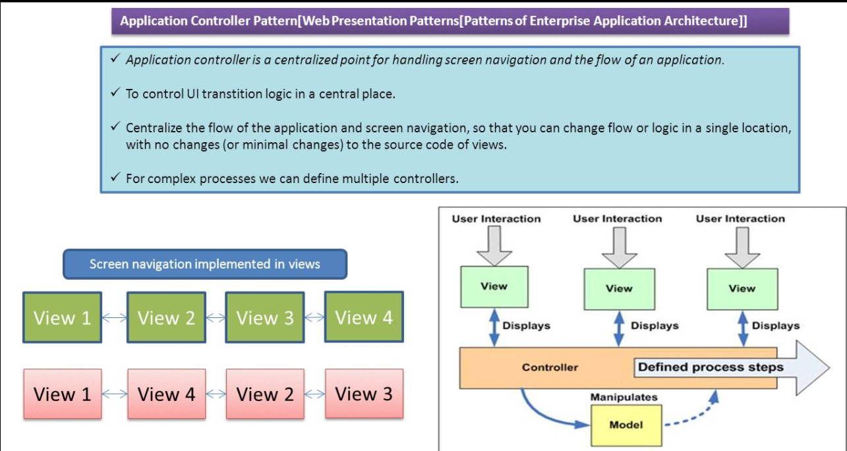
Application Controller Pattern

Slide 5
MVC
Model = data and the rules that govern access to and updates of this data. In enterprise software, a model often serves as a software approximation of a real-world process.
View = renders the contents of a model. It specifies exactly how the model data should be presented. If the model data changes, the view must update its presentation as needed. This can be achieved by using a push model, in which the view registers itself with the model for change notifications, or a pull model, in which the view is responsible for calling the model when it needs to retrieve the most current data.
Controller = translates the user's interactions with the view into actions that the model will perform. In a stand-alone GUI client, user interactions could be button clicks or menu selections, whereas in an enterprise web application, they appear as GET and POST HTTP requests. Depending on the context, a controller may also select a new view -- for example, a web page of results -- to present back to the user.

Slide 6
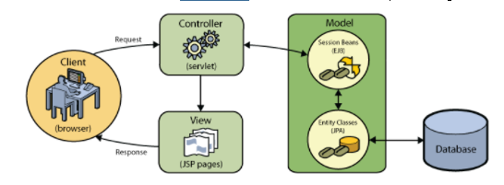
MVC Diagram

Slide 7
References
http://www.corej2eepatterns.com/ApplicationController.htm
http://forum.codecall.net/topic/72183-mvc-application-in-java/
https://ramj2ee.blogspot.com/2013/08/application-controller-design-pattern.html#.WdKOGGhSyM8

